Slide 1

The data class a.k.a. the Pandas class (but it’s not)
Pietro Berkes & Verjinia Metodieva

Slide 2
Data structures
This is an open question to the class
Which data structures do you know?
What makes you choose a data structure over another?
What do you consider, when thinking about data?
Notes:
Open questions and we collect the ideas on the whiteboard

Slide 3

Hands-on What data structure would you use to represent…

Slide 4
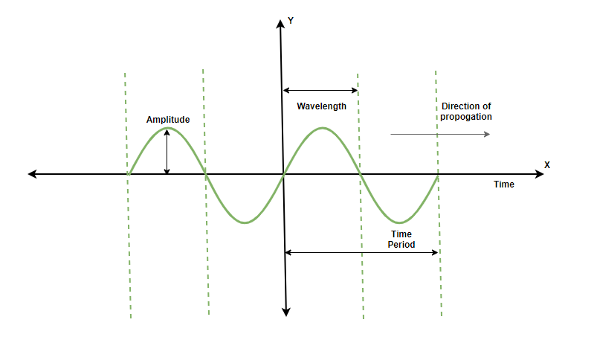
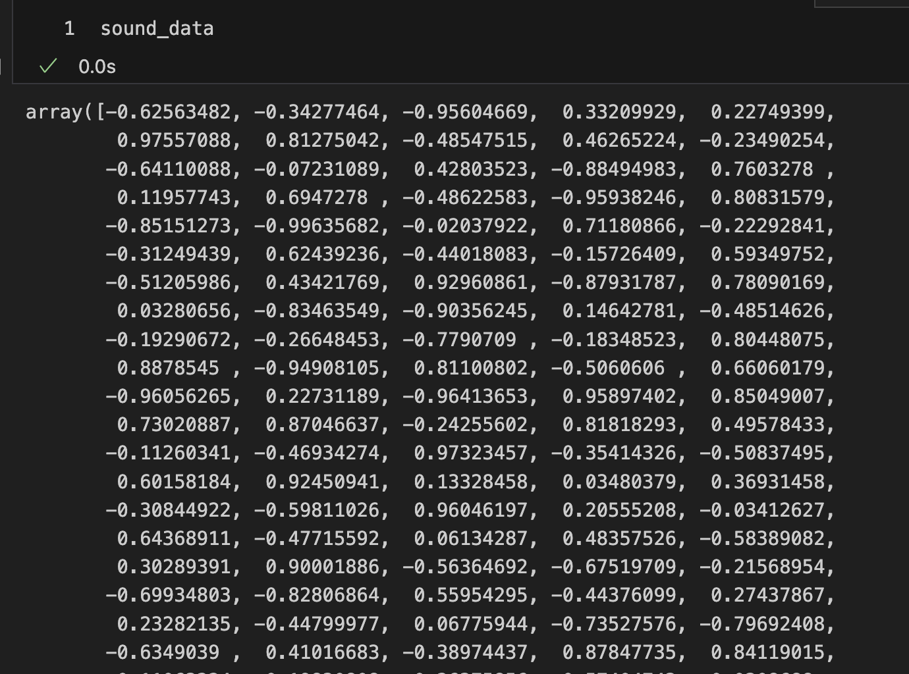
Hands-on What data structure would you use to represent…
a sound wave?
NumPy array

Slide 5
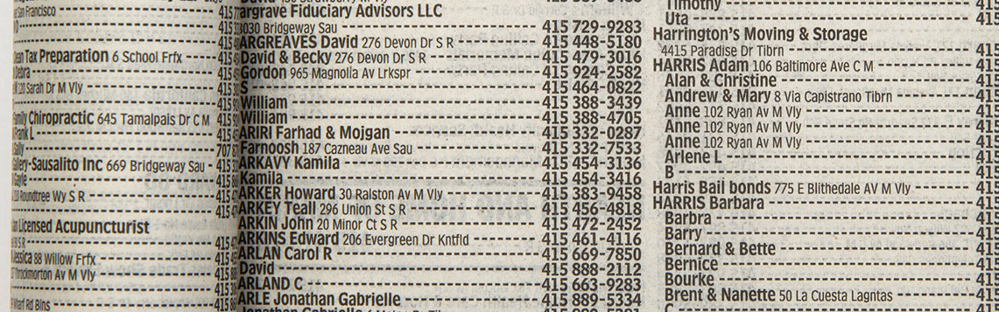
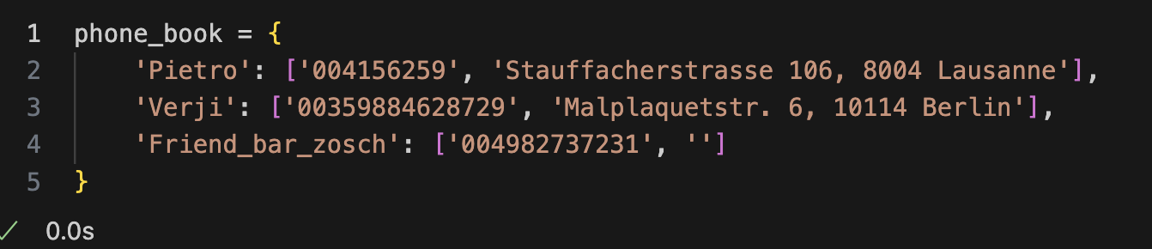
Hands-on What data structure would you use to represent…
phone book entries?
dictionary
maybe this one with a table?

Slide 6
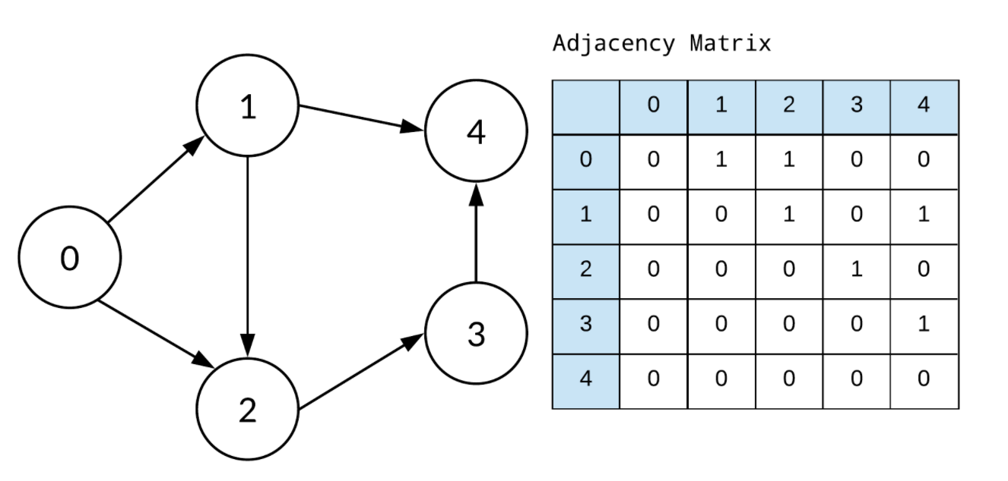
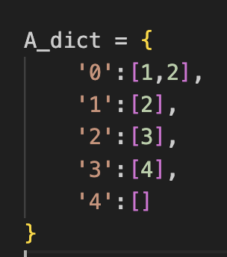
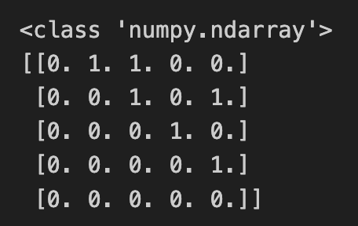
Hands-on What data structure would you use to represent…
OR
adjacency matrix
NumPy array
a graph?
dictionary
obvious but: different data structures are for storing different things
What are the criteria for picking a data structure over another?

Slide 7
Things to think about when choosing a data structure
Processing
Storage
Reproducibility and collaboration
Efficient processing (no for-loops!)
Organizing data so that analyses are easy
Size
Access ease
Access time
Versioning
Lineage tracing (which script / other data was used to generate this?)
Ease of sharing

Slide 8
You develop your code on a small data set, how is it going to scale to the complete data set?
Development data
Real data
N data points,
Processing time T
10x N data points
Processing time -> ?
We’re interested in orders of magnitude
Notes:
Data and code are related.
Nice transition from the last question. In extreme case, when the relations in the graph are dynamic/ changing a lot →using a dictionary is not a good solution. Instead, when small dataset and we are mainly interested in visualizing the relations, it might be.
The NumPy array solutions, scales much better, in case there are hundreds of dynamically changing relations to inspect.

Slide 9
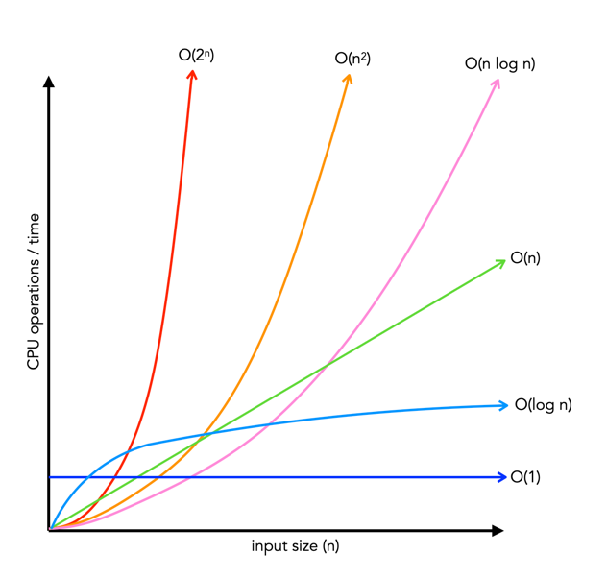
How performance scales: big-O
Big-O class | What we call it | Time increase, when data increases 10x
O(1) | constant | 1x time
O(n) | linear | 10x time
O(n²) | quadratic | 100x time
O(n * log n) | linearithmic | ~10-20x time
O(log n) | logarithmic | ~1-2x time
O(2^{n})
O(n²)
O(n log n)
O(n)
Time
O(log n)
O(1)
Input size, n

Slide 10
Hands-on: Complexity of operations on lists
Big-O class | What we call it | Time increase, when data increases 10x
O(1) | constant | 1x time
O(n) | linear | 10x time
O(n²) | quadratic | 100x time
O(n * log n) | linearithmic | ~10-20x time
O(log n) | logarithmic | ~1-2x time
O(2^{n})
O(n²)
O(n log n)
O(n)
Time
Big-O class | Operation on lists that scales this way
O(1)
O(n)
O(n²)
O(n * log n)
O(log n)
O(log n)
O(1)
Input size, n

Slide 11
Hands-on: Complexity of operations on lists
Big-O class | What we call it | Time increase, when data increases 10x
O(1) | constant | 1x time
O(n) | linear | 10x time
O(n²) | quadratic | 100x time
O(n * log n) | linearithmic | ~10-20x time
O(log n) | logarithmic | ~1-2x time
O(2^{n})
O(n²)
O(n log n)
O(n)
Time
Big-O class | Operation on lists that scales this way
O(1) | Getting an element by its index
O(n) | Summing elements in list
O(n²) | Computing distance between all pairs of elements in the list
O(n * log n) | Sorting the list
O(log n) | Searching an element in a sorted list
O(log n)
O(1)
Input size, n

Slide 12
Example: Find common words
Given two lists of words, extract all the words that are in common
Expected result: ['apple', 'orange', 'banana']

Slide 13
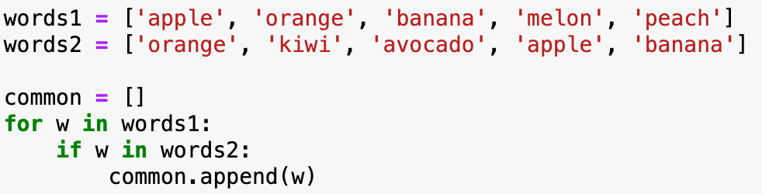
Implementation with two for-loops
What is the big-O complexity of this implementation?

Slide 14
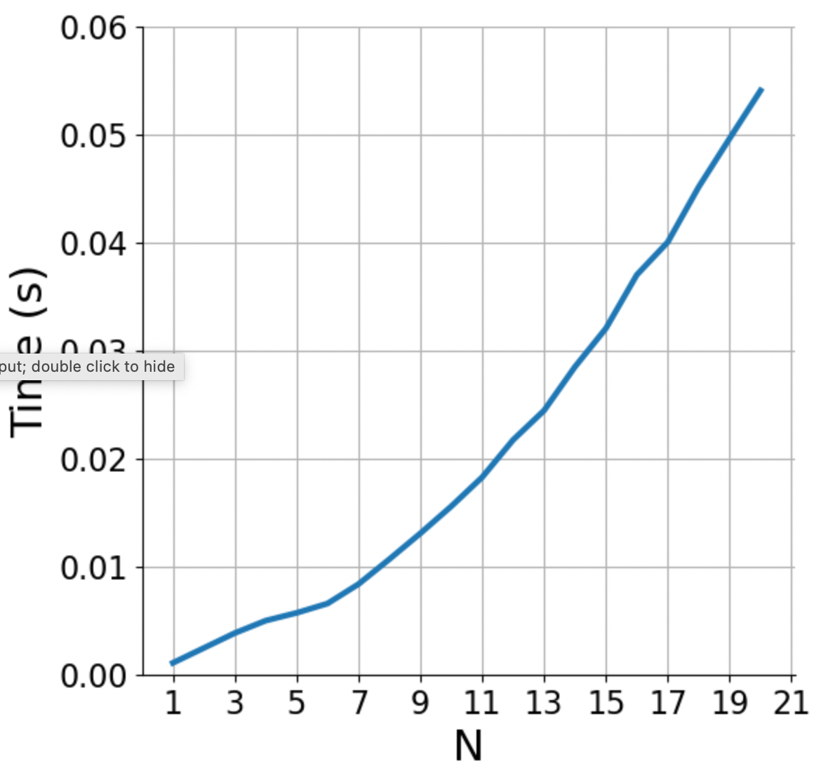
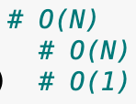
Implementation with two for-loops
What is the big-O complexity of this implementation?
N * N ~ O(N²)

Slide 15
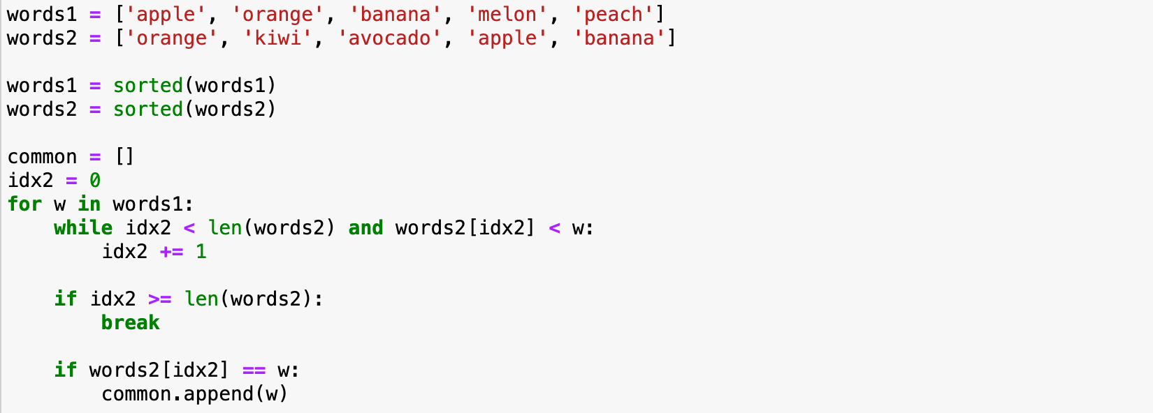
Implementation with sorted lists
What is the big-O complexity of this implementation?

Slide 16
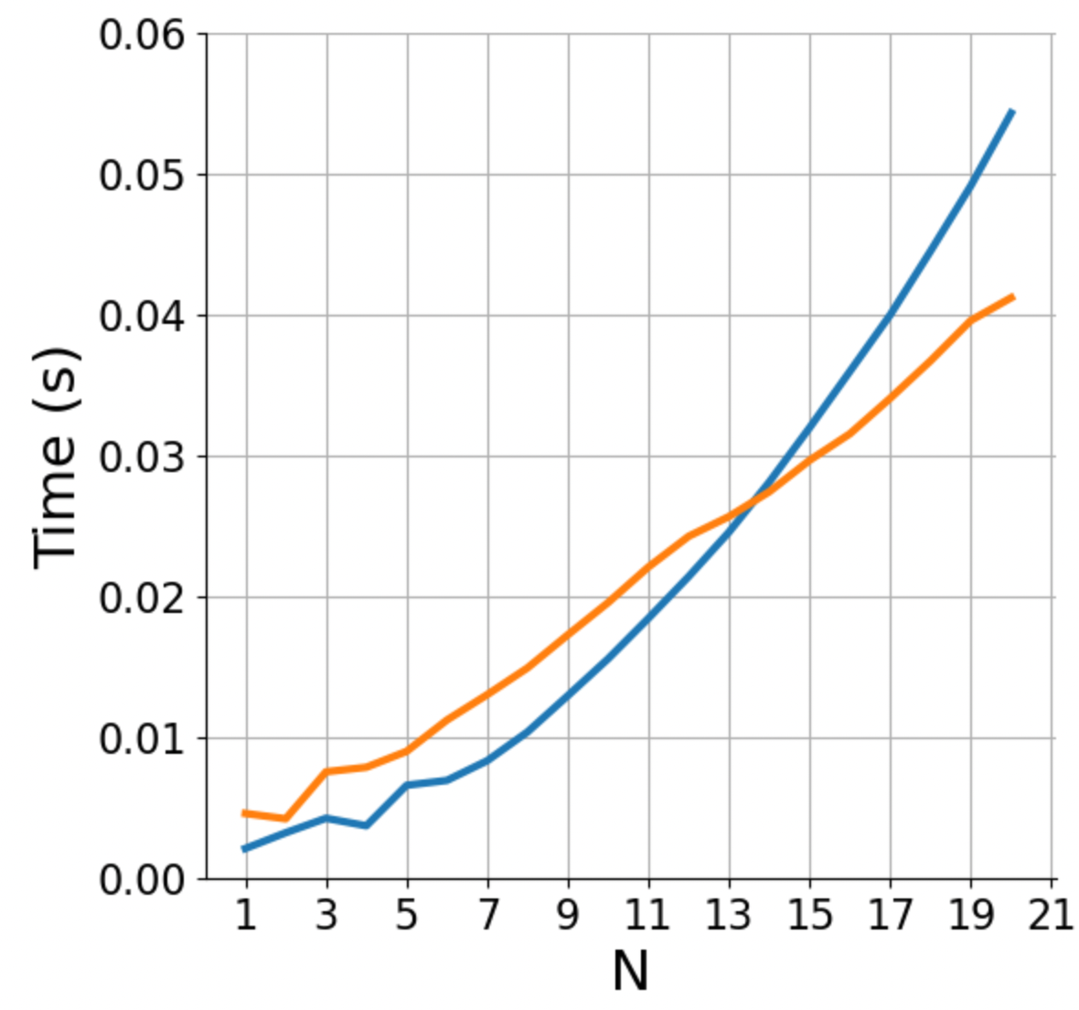

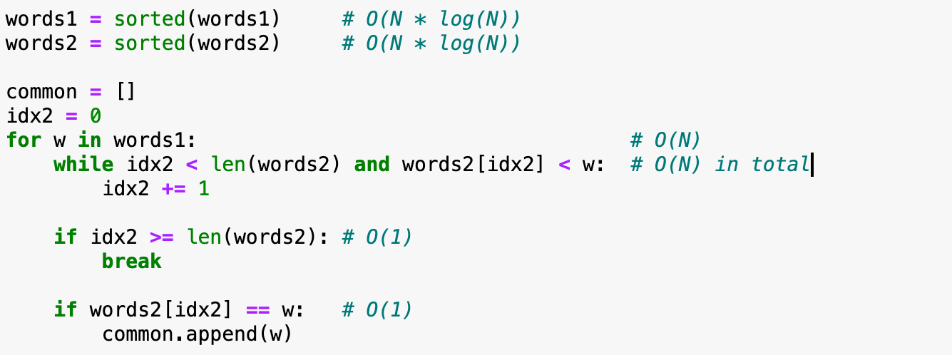
Implementation with sorted lists
What is the big-O complexity of this implementation?
2 * (N * log(N)) + 2 * N ~ O(N log N)

Slide 17
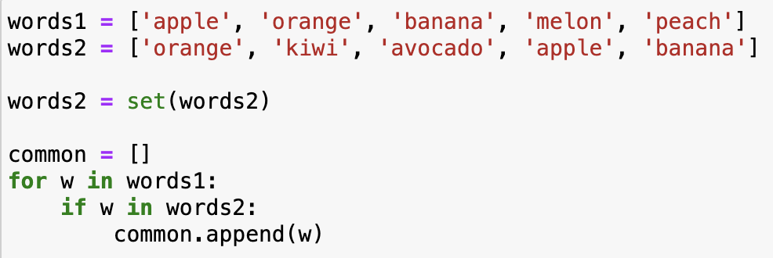
Implementation with sets
What is the big-O complexity of this implementation?

Slide 18
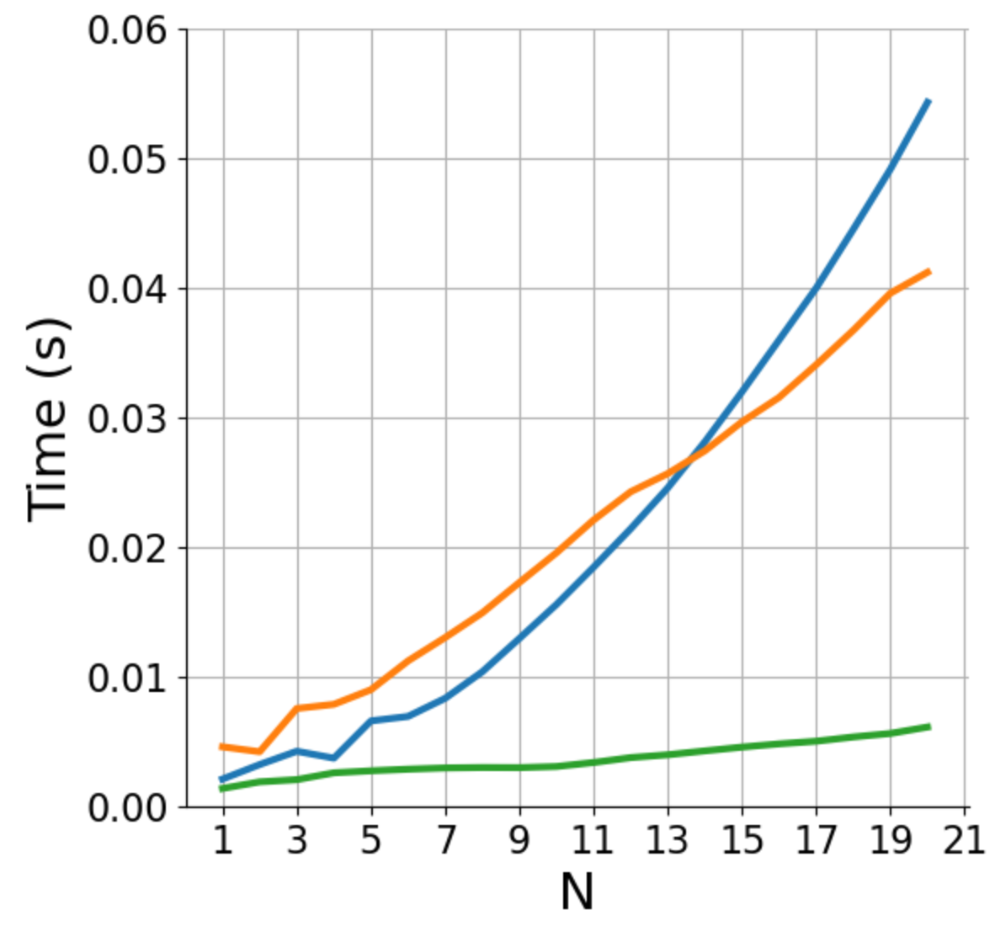
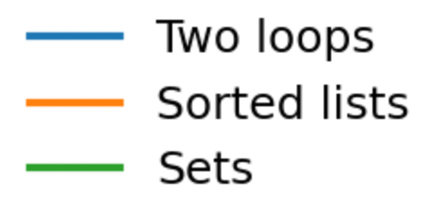
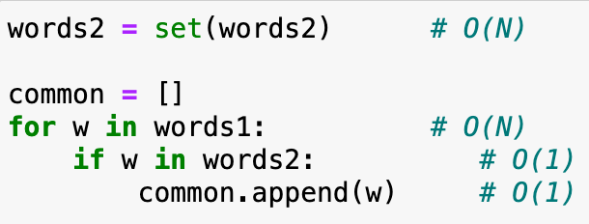
Implementation with sets
It’s the exact same code as for lists, but now looking up an element in sets (if w in words2) takes constant time!
How could you have known that set lookup is fast? Learning about data structures!
What is the big-O complexity of this implementation?
N + N ~ O(N)

Slide 19
Basic information about Python data structures
lists: collection of ordered, arbitrary data
getting an element by index: O(1)
appending: O(1)
inserting an element: O(n)
sorting: O(n * log n)
finding an element (e.g., ”if element in my_list: …”): O(n)
dictionaries (”hashmaps”)
inserting: O(1)
finding element by key: O(1)
sets (it’s just dictionaries without values)
inserting: O(1)
finding an element (e.g., ”if element in my_set: …”): O(1)
Notes:
Note that there may be different implementations of these data structures with different complexities, these are for the Python implementation.
E.g., if finding an element in a list is important, one could implement it as two dictionaries, one mapping indices to data, one mapping data to indices. Finding out the complexities of all the operations with this implementation is left as a homework.

Slide 20
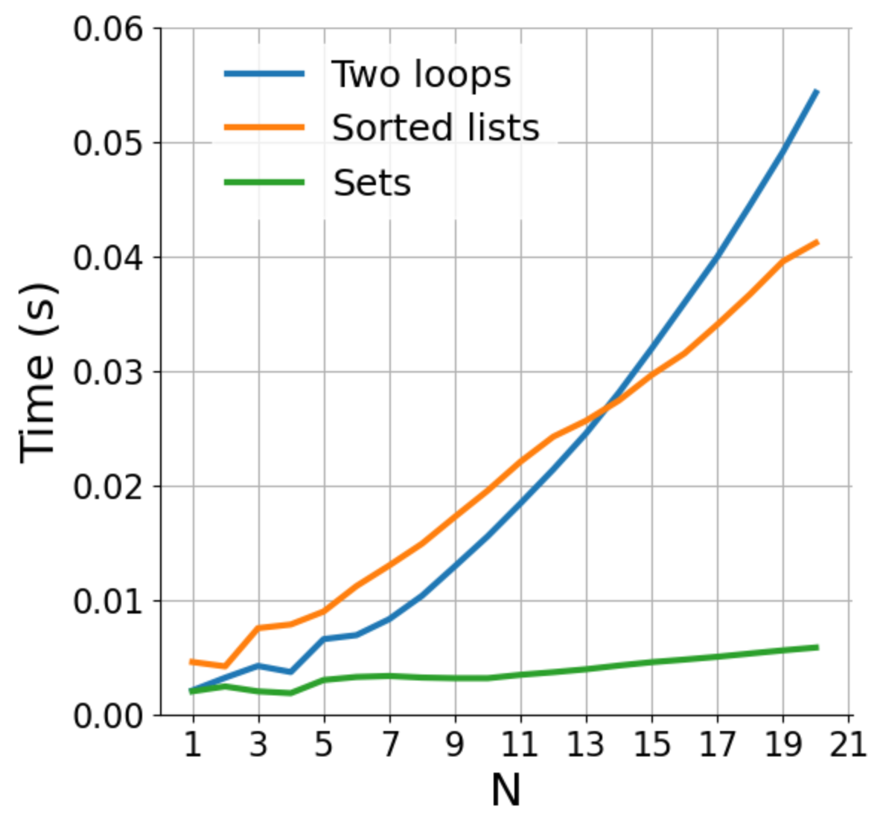
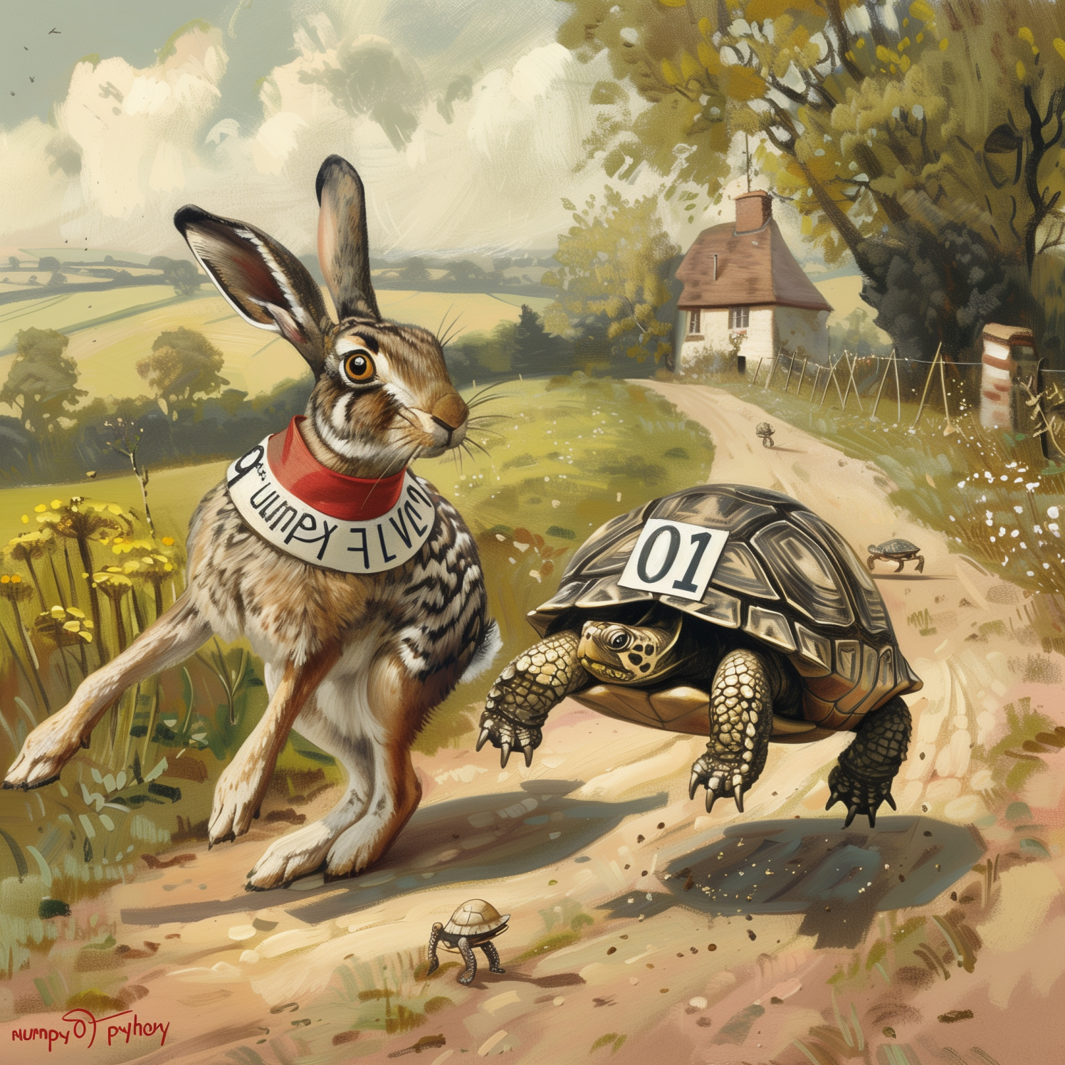
How does parallelization influence the performance?
Fast code
O(n²)
Regular code
O(n)
Notes:
Parallelization lowers the curves.
For a fixed code, linear code is no necessarily faster.
Important when n is growing
Parallelization/ optimization → you can make the code faster for any fixed N, but the shape (of growth) can never change

Slide 21
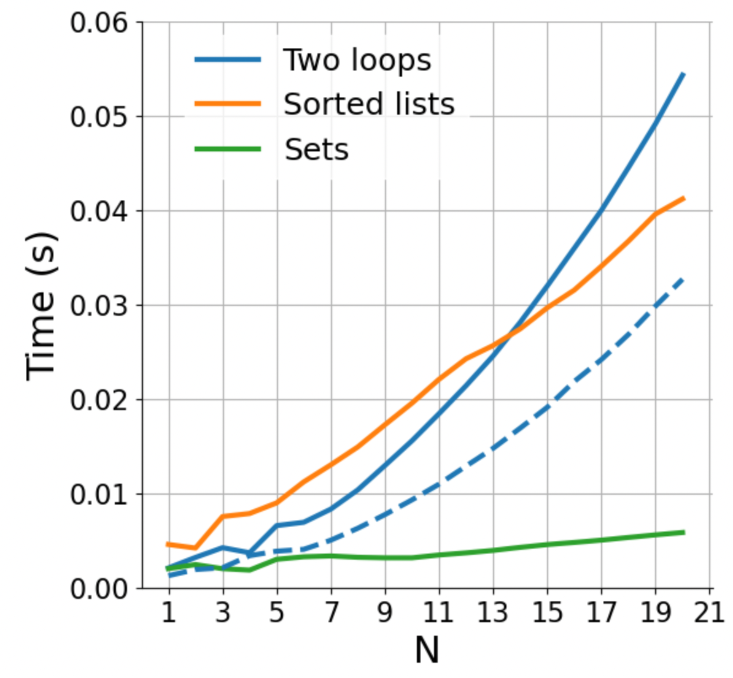
How does parallelization influence the performance?
Fast code
O(n²)
Regular code
O(n)
Notes:
Parallelization lowers the curves.
For a fixed code, linear code is no necessarily faster.
Important when n is growing
Parallelization/ optimization → you can make the code faster for any fixed N, but the shape (of growth) can never change

Slide 22
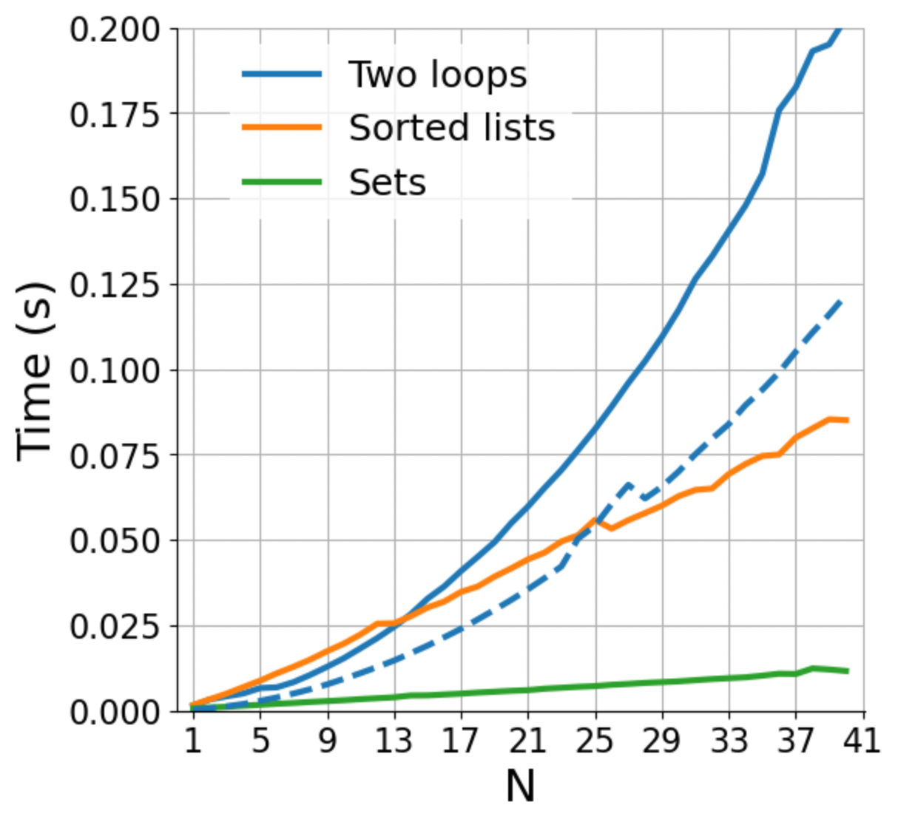
How does parallelization influence the performance?
Fast code
O(n²)
Regular code
O(n)
Notes:
Parallelization lowers the curves.
For a fixed code, linear code is no necessarily faster.
Important when n is growing
Parallelization/ optimization → you can make the code faster for any fixed N, but the shape (of growth) can never change

Slide 23
How does parallelization influence the performance?
We need to distinguish between “fast” in absolute terms for a fixed problem size, and “fast” in the sense of how well it scales
Fast code
O(n²)
Regular code
O(n)
Notes:
Parallelization lowers the curves.
For a fixed code, linear code is no necessarily faster.
Important when n is growing
Parallelization/ optimization → you can make the code faster for any fixed N, but the shape (of growth) can never change

Slide 24
Hands-on
Exercise
exercises/anagrams
You are given an English dictionary containing M words (“the dictionary”), and a separate list of N words (“the input”)
For each word in the input, find all the anagrams in the dictionary (e.g., for input 'acme' the anagrams are ['acme', 'came', 'mace’])
Write an algorithm to solve this problem, and compute its Big-O class
Submit a PR for Issue #? on GitHub

Slide 25
COMING UP NEXT: NumPy, the array data structure

Slide 27
Data class outline
TO BE REMOVED
Introduction
what data structures do you know? list, dictionary, set, tree, graph, array, database, …
you could store data in a dictionary as a list — what makes you choose a data structure over another? speed (dictionary retrieval O(1), list O(n), demo this) memory (on disk, in memory)
for what kind of data is each of the data structure good? list, dictionary … numpy array -> n-d grid of data of the same basic type; efficient use of memory and for loops implemented at C-level for some operations pandas DataFrame -> records of different types, e.g. info about experiment subscriber, experiment results by subscriber and condition, … ; efficient operations on columns; easy statistics and analytics on groups
homogeneous array data: numpy
only small changes to numpy class to stress the overall topics
one thing I suggest to add: memmap. What does it do, how much in this case it’s important to think about the operations we want to do on the array: view vs copy; random sampling is going to load all of the memory pages the samples are in. Even C- and Fortran-order are going to have a different impact on memory usage
mention that HDF5 can also be used for efficient on-disk storage of array data
heterogeneous, column-based data with index: pandas
the topics of this part apply to pandas, spark, SQL databases, dask, … : they all share the same basic concepts; we’ll use pandas for convenience
“tidy data” ideas
just as in numpy, avoiding for loops is critical for both memory and speed consumption
split, map, aggregate -> basic ideas, related to tidy data; summary tables, pivots
joins and anti-joins: basic and also how they can make some filtering cases easy, without for loops
window functions
coalescing: selecting one of several computations based on priority (eliminates if .. else mapping)
briefly discuss strengths of pandas, spark, SQL databases, dask
(possibly) data organization topics
data processing stages
handling changes in the data
missing values

Slide 28
TO BE REMOVED
Part 1: data structures
which data structures exist?
which ones do we use most commonly in research? array, tables
why do we have many?
access time, memory, and algorithms (exercise)
Part 2: arrays (numpy)
why is it efficient? separate storage in memory from interpretation; copy vs view; broadcasting
it’s only efficient if you don’t do for loops: the for loops are done in the native C
exercises for that
memory maps -> on-disk arrays
HDF5 -> on-disk, chunked arrays
more: compressed storage (blosc)
Part 3: tables (pandas, dask, SQL, …)
calculations are done by column, rows have index
it’s only efficient if you don’t do for loops: split-group-appy, join, window functions
exercises for that
concept of “tidy data”, show example of difficult operation on table that becomes easy with tidy data

Slide 29
Data types
TO BE REMOVED
obvious but: different data structures are for storing different things
lists: sequences, ordered items -> stack, queue; sorted search
sets: bunch of items, no order
dictionaries: key-value
what’s maybe not obvious is that these data structures are specialized because they have speed or memory advantages
Q: what is the time to retrieve an item from a list? from a dictionary? from a set?
Numpy also is a specialized data structure
Q (exercise): what data structure would you use to represent
a graph? A: either a dictionary or a numpy array (adjacency matrix)
a sound wave?
have a look at Advent of Code to find other examples
Notes:
Bugs are inevitable

Slide 30
All the data structures
list: ordered, heterogeneous storage, stack/queue, fast access by index, slow search
set: unordered
dictionary
arrays: e.g. numpy, HDF5
tables: e.g. pandas, dask, spark, SQL
graph: social network structure
tree: to rapidly search a dataset
heap
stack
queue
priority queue

Slide 31
Data structures
TO BE REMOVED
You might know the native Python data structures (ask which ones): lists, tuples, sets, and dictionaries
There are also other data structures in the standard libraries
There is a whole theory of data structures
For example:
queue
priority queues
I want to give a taste of how to think about data structures:
what is stored
what are the operations that can be done on them
how they are implemented and how efficient that is, is another matter (e.g. representation of graphs in matrices vs dictionaries)
you don’t need to know the implementation, just the efficiency of each operation

Slide 32
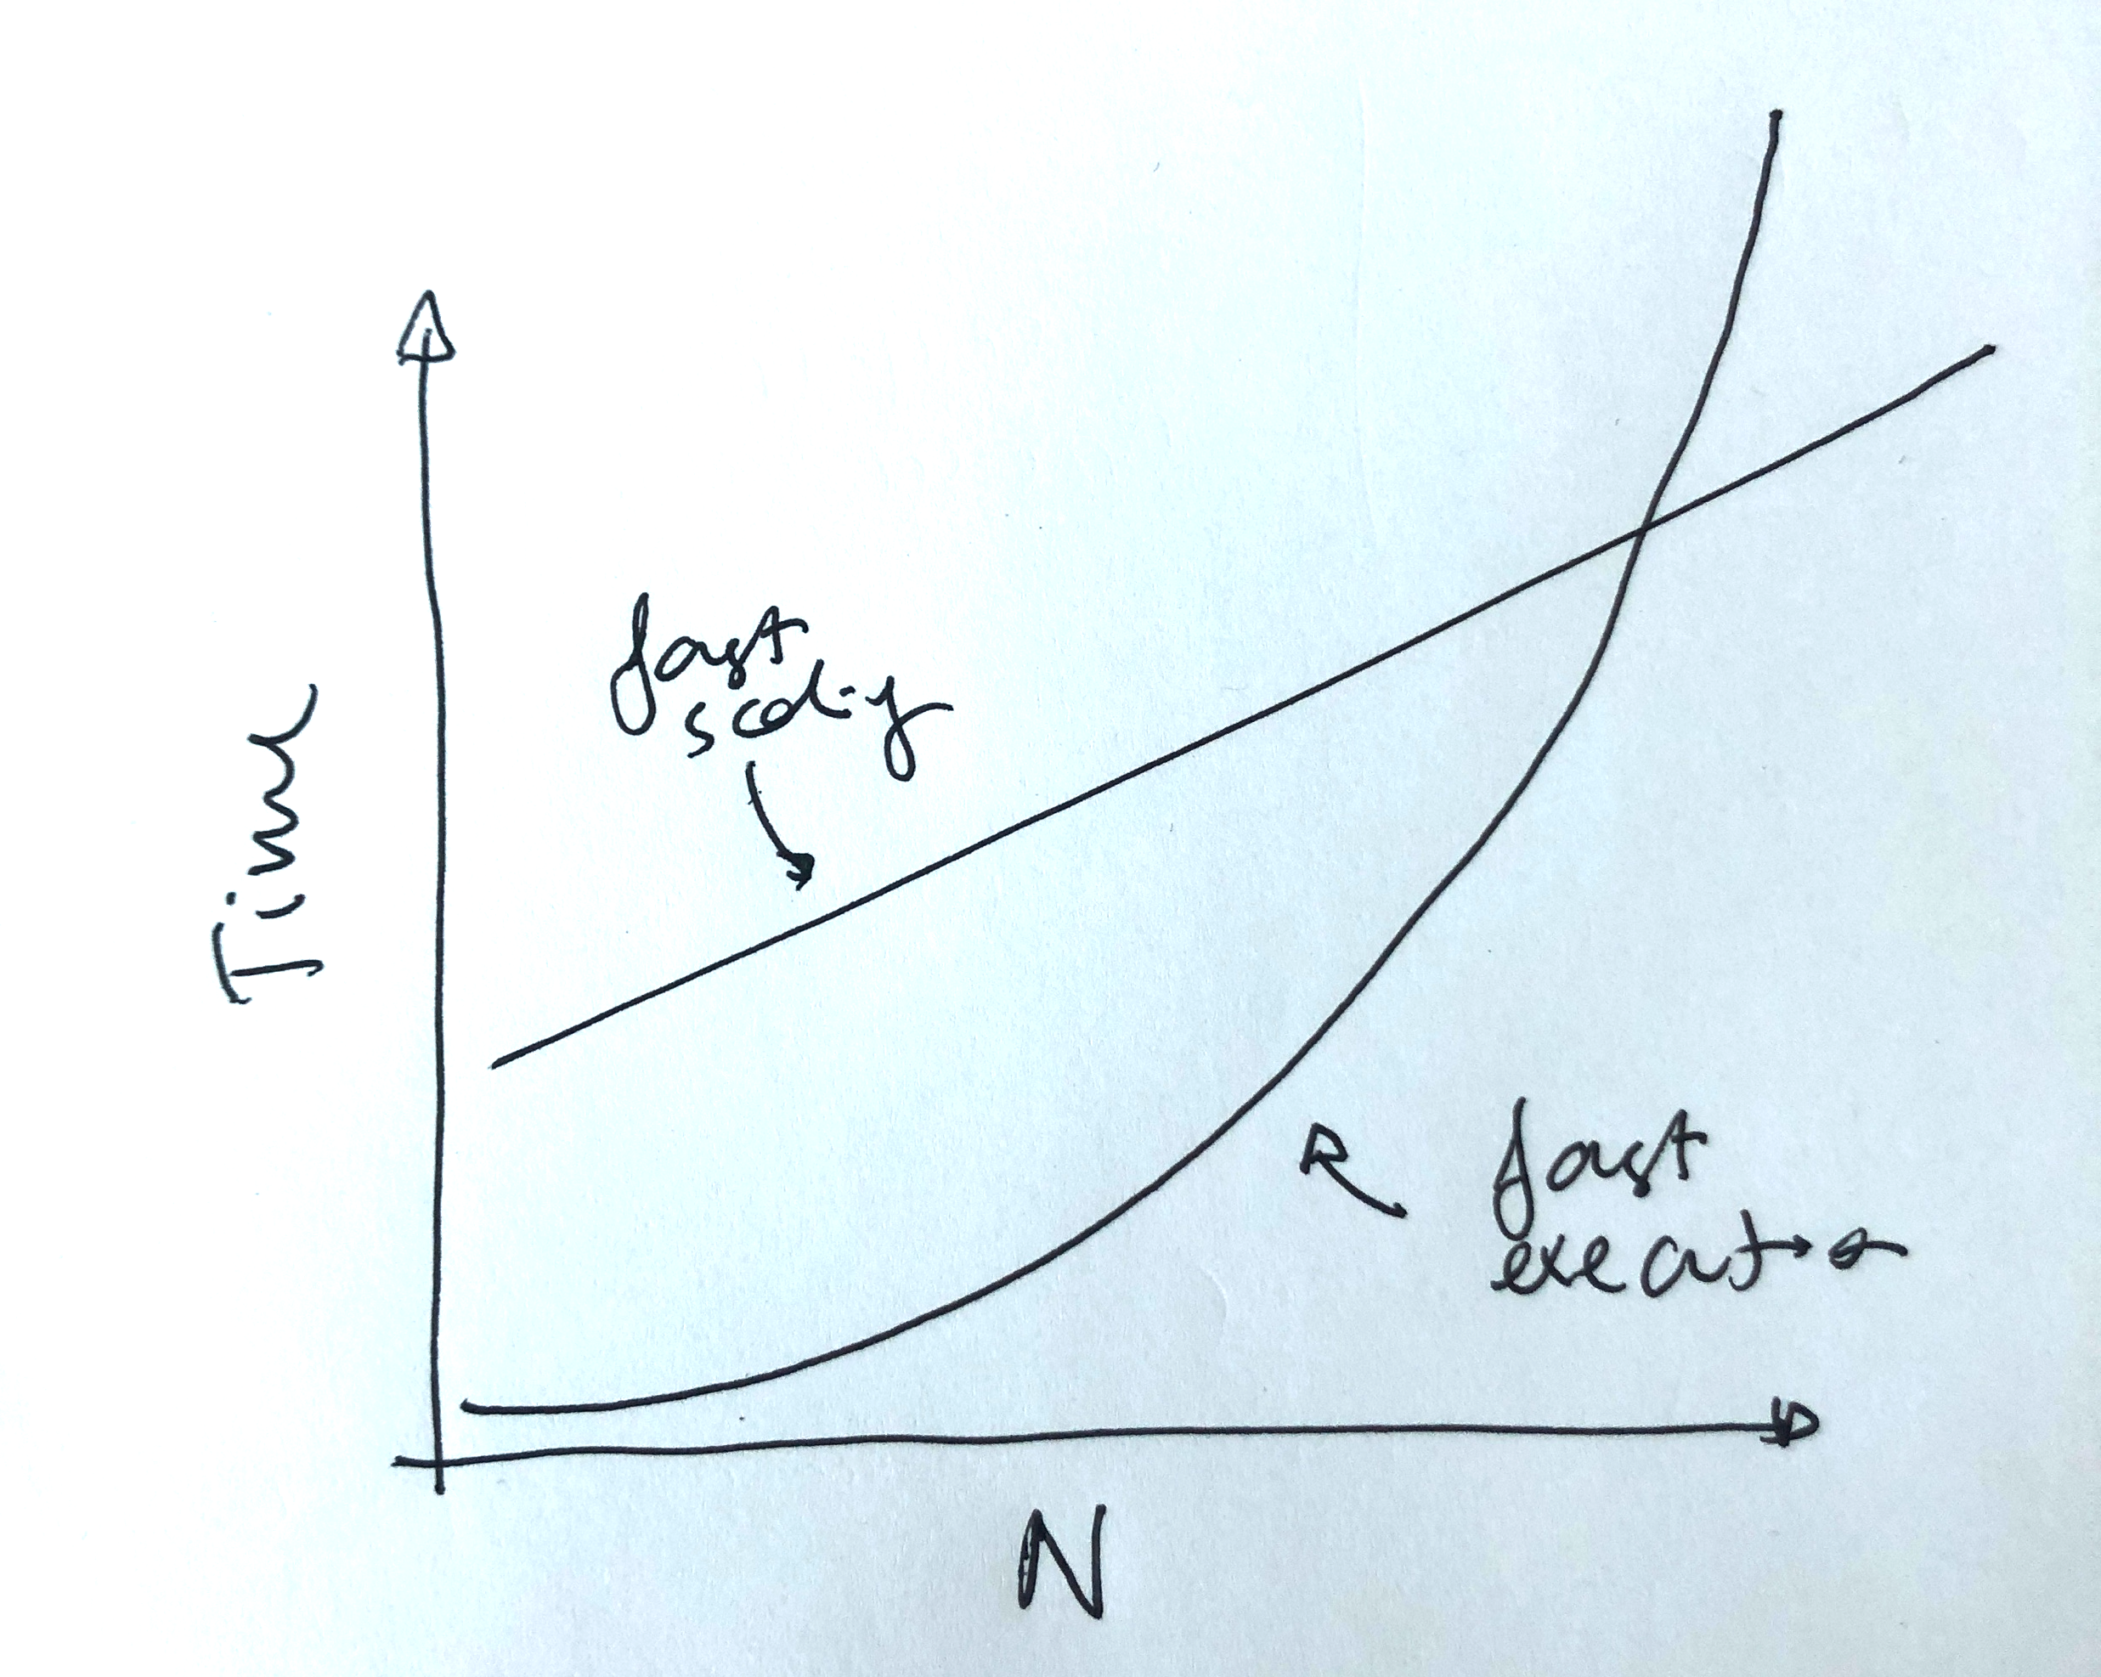
We need to distinguish between “fast” in absolute terms for a fixed problem size, and “fast” in the sense of how well it scales
Fast code
O(n²)
Regular code
O(n)
Slow execution
Fast scaling O(n)
Parallelizing, rewriting in faster language
Fast execution
Slow scaling O(n^2)
Notes:
Parallelization lowers the curves.
For a fixed code, linear code is no necessarily faster.
Important when n is growing
Parallelization/ optimization → you can make the code faster for any fixed N, but the shape (of growth) can never change

